Slide 1
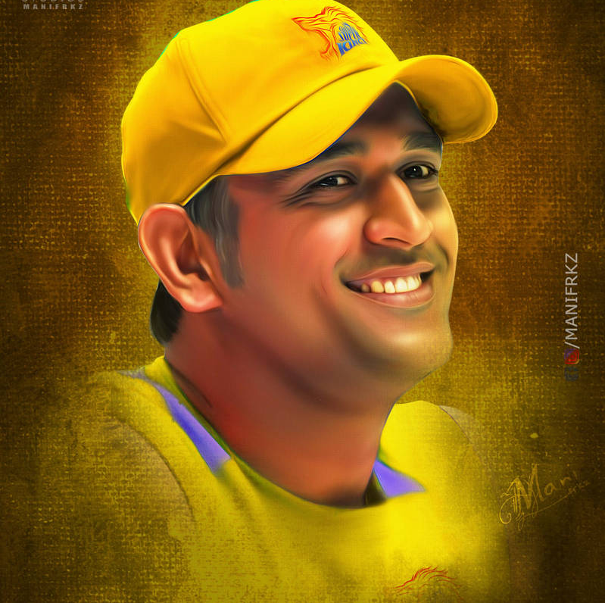
Is MS Dhoni Still Good Enough to Bat?
Week 1
Assignment
By Abhishek Girish Nadkarni
This Photo by Unknown Author is licensed under CC BY-NC-ND

Slide 2
Mahendra Singh Dhoni - Career Summary
Batting | M | Inn | NO | Runs | HS | Avg | BF | SR | 100 | 200 | 50 | 4s | 6s
Test | 90 | 144 | 16 | 4876 | 224 | 38.09 | 8248 | 59.12 | 6 | 1 | 33 | 544 | 78
ODI | 350 | 297 | 84 | 10773 | 183 | 50.58 | 12303 | 87.56 | 10 | 0 | 73 | 826 | 229
T20I | 98 | 85 | 42 | 1617 | 56 | 37.6 | 1282 | 126.13 | 0 | 0 | 2 | 116 | 52
IPL | 234 | 206 | 79 | 4978 | 84 | 39.2 | 3682 | 135.2 | 0 | 0 | 24 | 346 | 229
Bowling | M | Inn | B | Runs | Wkts | BBI | BBM | Econ | Avg | SR | 5W | 10W
Test | 90 | 7 | 96 | 67 | 0 | 0/1 | 0/1 | 4.19 | 0.0 | 0.0 | 0 | 0
ODI | 350 | 2 | 36 | 31 | 1 | 1/14 | 1/14 | 5.17 | 31.0 | 36.0 | 0 | 0
T20I | 98 | - | - | - | - | - | - | - | - | - | - | -
IPL | 234 | - | - | - | - | - | - | - | - | - | - | -
Source: cricbuzz.com

Slide 3
Points Covered in MS Dhoni Data Analytics
Batting Performance Post 2018 in IPL in Death Overs
Strike Rate post 2018 in IPL in Death Overs
Comparison in Runs Scored along with the best Middle Order Batters in IPL Post 2018
Runs Scored in Entire IPL i.e. 2008-2022
Number of Boundaries scored over the years in IPL
Dot Ball Percentage over the Years in IPL
Tools used:
Jupyter Notebook
Microsoft Excel
Microsoft Powerpoint
IPL data from cricsheet.org

Slide 4
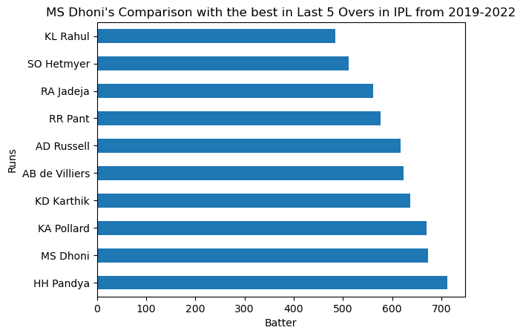
Batting Performance Post 2018 in IPL in Death Overs
On Analyzing Runs Scored by MS Dhoni in the Death Over (15-20 overs) post 2018 in IPL, it is observed that if not the best he is still one of the best batters to have played in the finishing stages. He is still a good finisher.

Slide 5
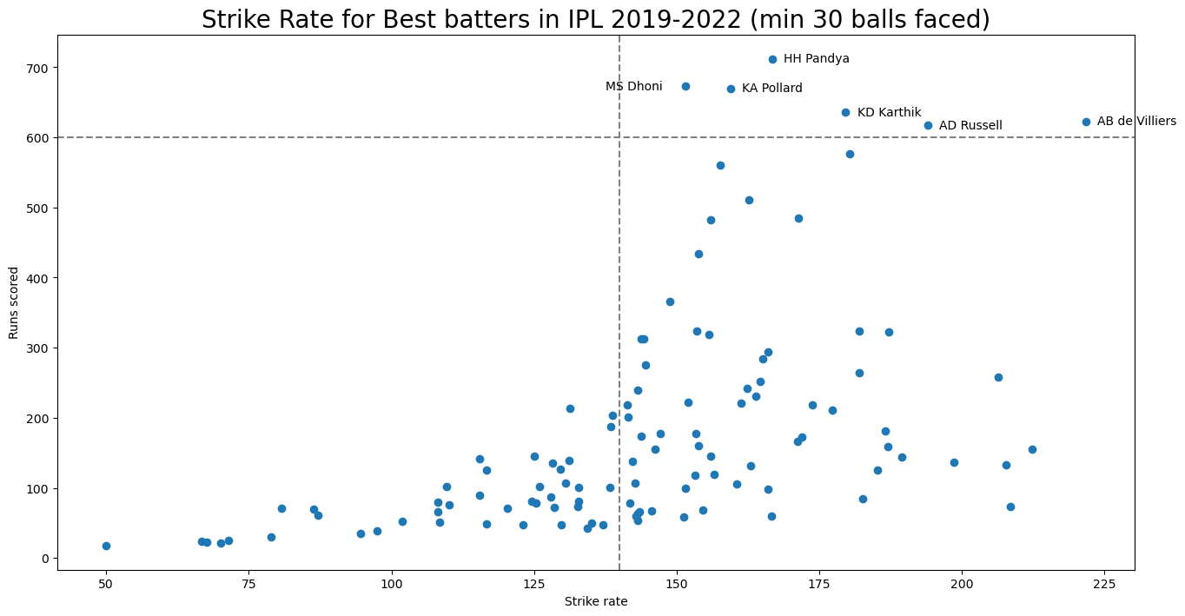
Strike Rate post 2018 in IPL in Death Overs
On
The graph shows analysis of MS Dhoni’s Strike rate in the Death Overs in the last 4 years of IPL. It is an excellent strike rate of 151.58. Having said that he has scored more than 900 runs post 2018. So according to the previous & current slide analysis we can say that MSD is still one of the BEST FINISHERS of IPL.

Slide 6
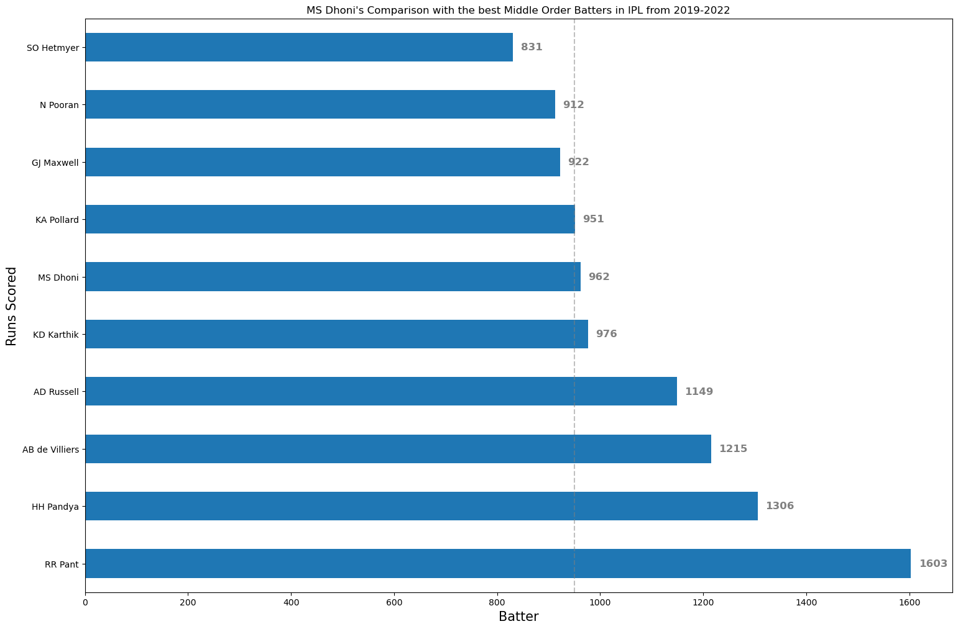
Comparison in Runs Scored along with the best Middle Order Batters in IPL Post 2018
In T20 middle order batters have become extremely important as they need to be good partnership makers as well as hard hitters. They even need to try and play as long as possible if there is a top order collapse. The graph shows that MSD has scored more than 900 runs and is still one of the best Middle order Batter.

Slide 7
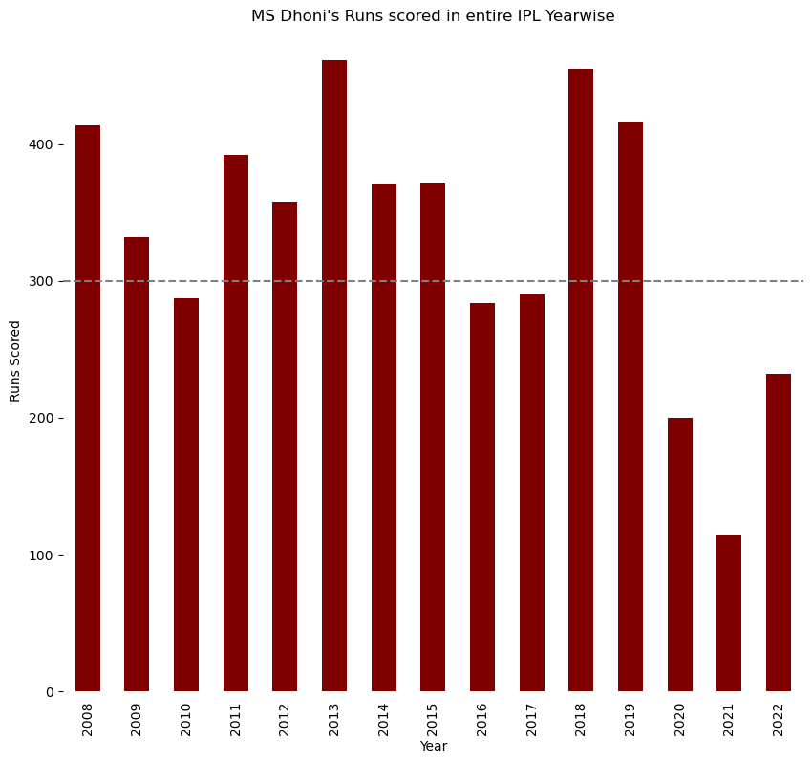
Runs Scored in Entire IPL i.e. 2008-2022
As you can see MSD has been scoring consistently since the birth of IPL and T20 Cricket. His aggressive style of batting as given him a lot of success for a long time as along with aggression there is a calm head on his shoulders. He is always analyzing the situation before playing in a certain way. He has always been a team player so he set himself as a Middle order batter to bring some stability in the Middle order.
However, in the last 3 years he has scored merely 200 runs in a season or even less. This shows a dip in the consistency.

Slide 8
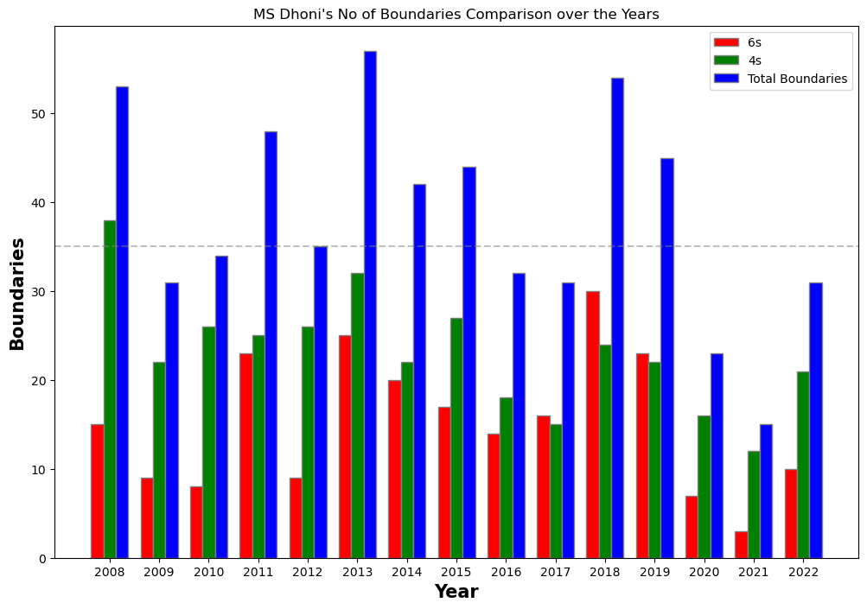
Number of Boundaries scored over the years in IPL
This analysis shows that MSD has been consistently scoring a lot of runs at and that too very quickly. He is consistently hitting a lot of boundaries over the years, more than 40 almost every year.
However, again in the last 3 years the boundaries have come down to around 30 or even less. This again suggests there has been a dip in form and bowlers have found a way to stop him from hitting boundaries consistently.

Slide 9
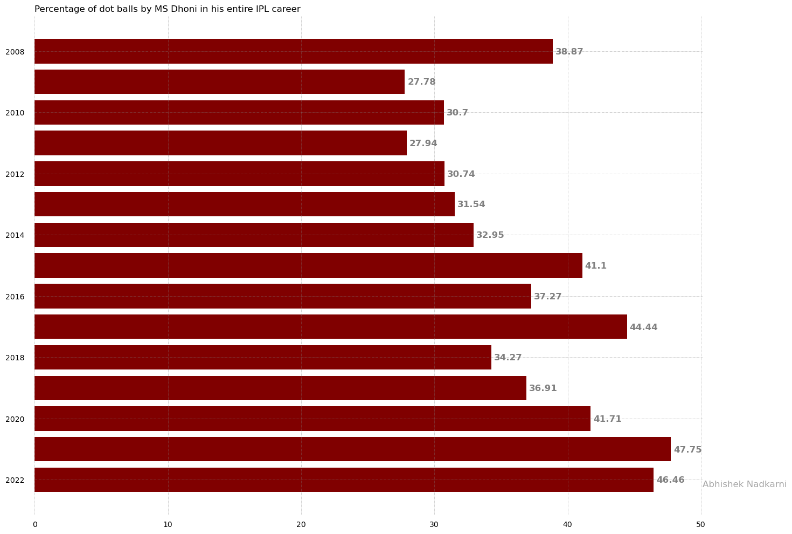
Dot Ball Percentage over the Years in IPL
This graph suggests how good was MSD before 2018. The dot ball percentage was around 30%
But in the last 3 years the dot ball percentage has almost touched 44% which cannot be acceptable for a middle order batter. As MSD generally comes to crease when run scoring has to be fast, high number of dot balls can put of a lot of pressure on the non striker which could result in losing wickets. An important point to think about!

Slide 10
Conclusion
From all the data that I have used to analyze Mahendra Singh Dhoni, it is quite obvious that almost 80-90% of his career has been like a dream to many crickets. He has been a wonderful ODI player and an extremely valuable T20 Player. His T20 numbers say it all. As a captain he has taken INDIAN CRICKET to next level for so many years. Him being the owner of all the ICC trophies is a huge statement in itself. However, as a batter his form since the last 3 years has been an issue. The high number of dot balls and low number of boundaries are troubling the team. Everyone is expecting 2023 to be the last year for him as a player. If that is true, I hope the retires with a bang. Afterall that’s what LEGENDS like MS DHONI are born to do!!!

